Slide 1




Slide 2





Slide 3





Slide 4




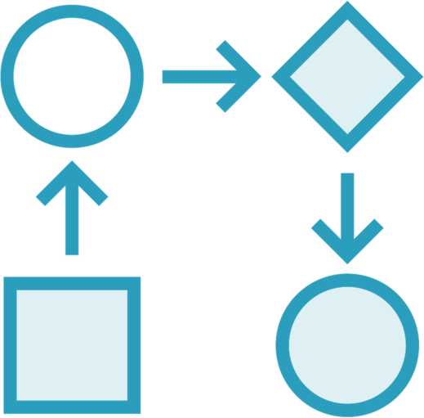




















Slide 5
























Slide 6










import React from "react";
import { useForm } from "react-hook-form";
◀
export default function App() {
const {register,handleSubmit,errors}= useForm();
◀
◀
const mySubmit = data => console.log(data);
return (
◀
<form onSubmit={handleSubmit(mySubmit)}>
<input {...register(”email")}/>
◀
{errors.email && <span>
This field is required</span>}
◀
<input type="submit" />
</form>
);
}

Slide 7






























Slide 8







Slide 9










Slide 10





<input {...register("name", {required: "error message"})} />
<input | type="number" | {...register("age", | {min: | { | value: | 18, | message: | "minor"}})} | />
<input | type="submit" | />

Slide 11

// npm install @hookform/resolvers yup
◀
import { useForm } from "react-hook-form"; import { yupResolver } from '@hookform/resolvers/yup’;
import * as yup from "yup";
◀
const schema = yup.object().shape({ name: yup.string().required()
});
◀
export default function App() {
const { register, handleSubmit, errors } =
useForm({ resolver: yupResolver(schema)});
◀
return (
<form onSubmit={handleSubmit(onSubmit)}>
<input {...register("name")}/>
<p>{errors.name?.message}</p>
◀
<input type="submit" />
</form>
);
}

Slide 12




Slide 13




Slide 14


